Slide 1
SUI BLOCKCHAIN: BRIDGING THE GAP TO WEB3
By,
VENKATESHA Y K 4VV22CS181
YASHWANTH S 4VV22CS189
YESH GOWDA 4VV22CS190
MANOJ KUMAR M 4VV23CS409

Slide 2
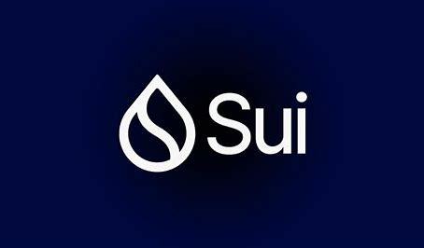
Introduction
Layer 1 Innovation: Developed by Mysten Labs, SUI
redefines scalability, security, and user experience.
Advanced Technology: Utilizes Move language, zkLogin,
and parallel processing.
Web3-Ready: Built for next-gen Web3 apps, NFTs, and
DeFi platforms.
High Performance: Offers speed, efficiency, and flexibility
for developers and users.

Slide 3
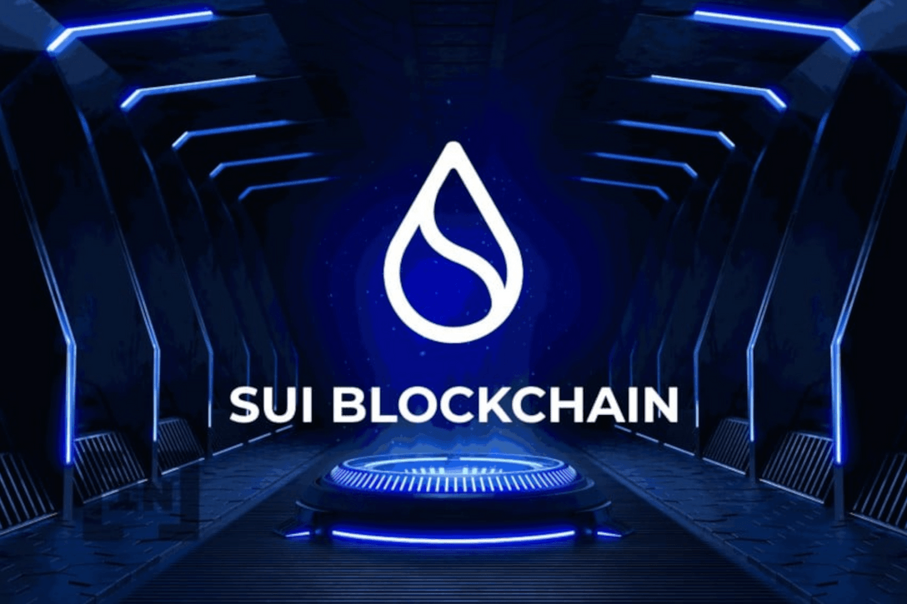
SUI Blockchain: A Vision Realized
zkLogin
Simplifies wallet authentication with web credentials
Move Language
Secure, efficient, and expressive blockchain programming
Parallel Processing
Processes transactions concurrently without bottlenecks
Programmable Blocks
Supports 1024 operations per single transaction

Slide 4
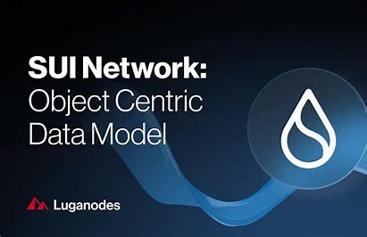
How SUI Blockchain Works
Smart Contracts
Secure and efficient with Move language
Fast Transactions
Parallel execution boosts speed dramatically
Consensus Mechanism
Narwhal DAG and Tusk finalize securely
Programmable Blocks
Ideal for gaming, DeFi, and e-commerce tasks

Slide 5
Advantages of SUI Blockchain
Scalability
Developer Friendly
Handles up to 297,000 TPS, Web2 competitive
Comprehensive tools and SDKs
Low Gas Fees
Security
Predictable and affordable for users
zkLogin and programmable blocks enhance privacy

Slide 6
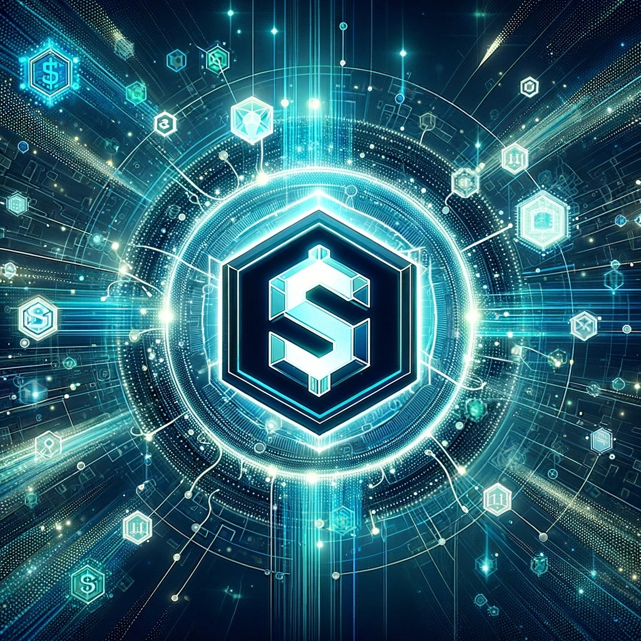




SUI Token: Features, Utility, and Future Potential
Transaction Fees
Validator Incentives
Governance
Token holders vote on protocol changes
Used to pay for blockchain operations
Staking rewards secure the network
Medium of Exchange
Used within dApps for seamless transactions

Slide 7
Bridging Assets to SUI with RocketX Exchange
Visit RocketX
Start your cross-chain asset journey
Connect Wallet
Supports MetaMask, Base, Arbitrum, and more
Select Tokens
Choose source and destination networks and tokens
Enter Address
Use valid SUI wallet (e.g., Suiet, Ethos)
Review & Confirm
Verify details and approve the swap
Complete Swap
Assets appear securely in your SUI wallet

Slide 8

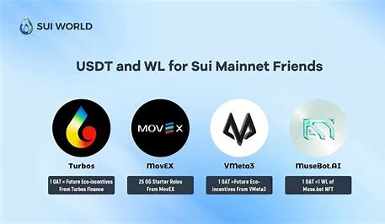


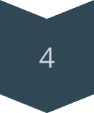
Embrace the Future of Blockchain with SUI
Scalability
Supports massive transaction volume
Energy Efficiency
Optimized for low consumption
Developer Empowerment
Rich tooling and SDKs included
Seamless Bridging
RocketX enables easy asset transfers
Unlock limitless decentralized opportunities with SUI’s innovative platform and cross-chain capabilities.

Slide 9

Thank You

